Slide 1
Artificial Intelligence CS-202
Topic: Game Playing and Adversarial Search
Habiba Arshad
Department of Computer Science
University of Wah

Slide 2
Week-5 and 6 CLO
This week lecture will cover the following CLO’s:
CLO1: Discuss the key concepts in the field of artificial intelligence
CLO 2: Implement artificial intelligence techniques and case studies

Slide 3
CLO’s Mapping
CLO 1:
Introduction
Game Playing in AI
Adversarial Search and the Minimax Algorithm
Cut-Off Search
Pruning Techniques (including Alpha-Beta Pruning)
CLO 2:
Implement
Adversarial Search and the Minimax Algorithm
Alpha-Beta Pruning
Case Studies: Chess and Checkers

Slide 4
Single Agent environment
Until now, we have discussed single agent environment
only one person or agent searching the solution space to find the goal or the solution.
often expressed in the form of a sequence of actions
There might be some situations where more than one agent/person is searching for the solution in the same search space
usually occurs in game playing where two opponents (adversaries) are searching for a goal.
Multi-agent environment
Notes:
Search strategies were only associated with a single agent/person that aims to find the solution

Slide 5
Multi-agent environment
The environment with more than one agent
Each agent is an opponent of other agent and playing against each other
Each agent needs to consider the action of other agent and effect of that action on their performance.

Slide 6
Introduction to Game Playing in AI
Definition: Game playing is a fundamental problem area for AI that focuses on creating intelligent agents to compete in games like chess, checkers, and more..
Types of Games: Deterministic (e.g., Chess, Checkers)Stochastic (e.g., Backgammon)The agent operates within a state space, where each state represents a configuration of the world.
Key Concepts:
Adversarial Search: Search strategies for games where agents compete against each other.
Goal: Develop strategies to maximize an agent's winning chances.

Slide 7
What is Adversarial Search
Definition
A type of search used in environments where agents (players) compete against each other. It is primarily used in games like Chess, Go, and Checkers, where each player's goal is to maximize their own payoff while minimizing that of their opponent.
Examples of Adversarial Games
Turn-Based Games: Chess, Checkers, Tic-Tac-Toe
Simultaneous Games: Poker, Rock-Paper-Scissors
Contrast with Regular Search
Unlike typical search problems, adversarial search involves dealing with uncertainty and the strategic counteractions of opponents.

Slide 8
Adversarial Search Overview
The Adversarial search is a well-suited approach in a competitive environment, where two or more agents have conflicting goals. The adversarial search can be employed in two-player zero-sum(utility/ payoff) based games which means what is good for one player will be the misfortune for the other. In such a case, there is no win-win outcome.
Adversarial search algorithms are the backbone of strategic decision-making in artificial intelligence, it enables the agents to navigate competitive scenarios effectively.
By employing adversarial search, AI agents can make optimal decisions while anticipating the actions of an opponent with their opposing objectives.

Slide 9
Why Adversarial Search is Important in AI
Strategic Decision-Making
Adversarial search equips AI agents with strategies to anticipate and counteract the moves of opponents.
Optimal Play
Helps in formulating strategies that can lead to the best possible outcomes, even in worst-case scenarios.
Application Beyond Games
The principles are applicable in fields like cybersecurity, economic modeling, and automated negotiations.
Modelling Human-Like Behaviour
By playing games and adapting strategies, AI systems can simulate human-like strategic reasoning.

Slide 10
Types of Games in AI
Perfect information
A game in which agents can look into the complete board.
Agents have all the information about the game, and they can see each other moves also.
Examples are Chess, tic-tac-toe, Checkers, Go, etc.
Imperfect information
A game in which agents do not have all information about the game and not aware with what's going on,
Examples are Battleship, blind, Bridge, etc.

Slide 11
Contd..
Deterministic games
Those games which follow a strict pattern and set of rules for the games, and there is no randomness associated with them.
Examples are chess, Checkers, Go, tic-tac-toe, etc.
Non-deterministic games/ Stochastic games
Those games which have various unpredictable events and has a factor of chance or luck.
This factor of chance or luck is introduced by either dice or cards. These are random, and each action response is not fixed.
Also called as stochastic games.
Example: Backgammon, Monopoly, Poker, etc.

Slide 12
Game Theory
Mathematical model for decision making
Analysis of strategic actions in scenarios which can be defined as games.

Slide 13
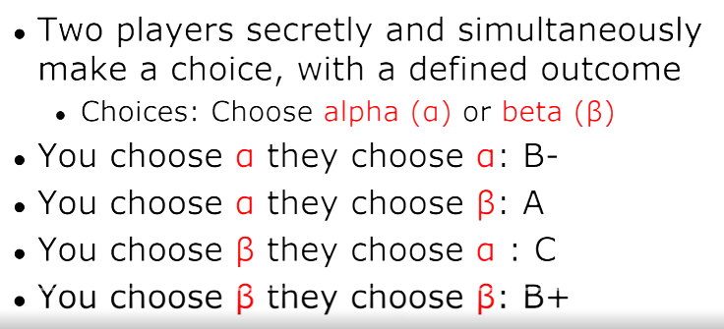
Grades Game

Slide 14
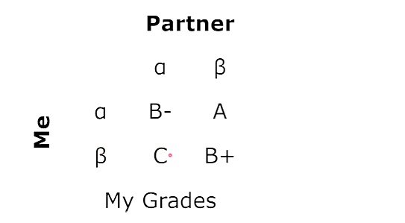
Grades Game

Slide 15
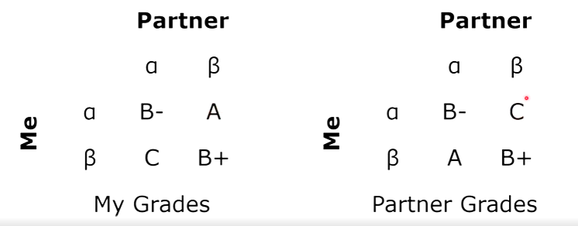
Game1: Grade Game

Slide 16
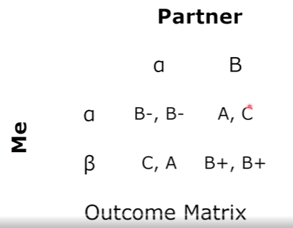
Grades Game

Slide 17
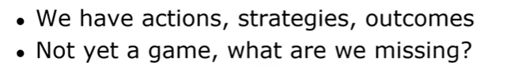
Grades Game

Slide 18
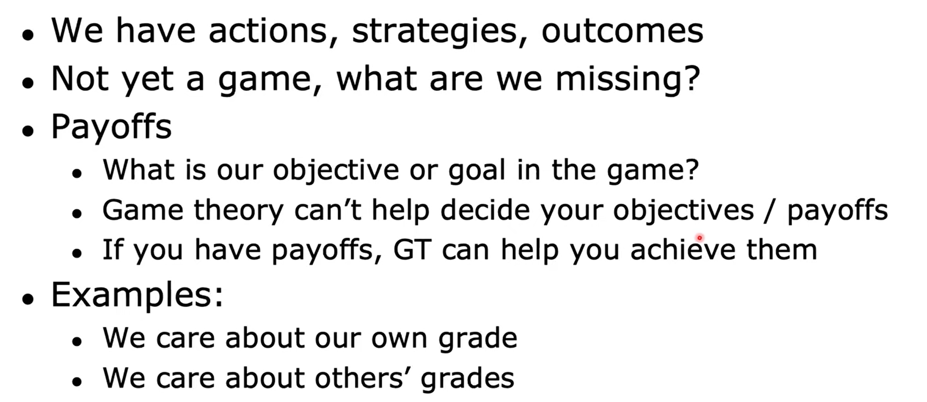
Grade Game
(Utility)

Slide 19
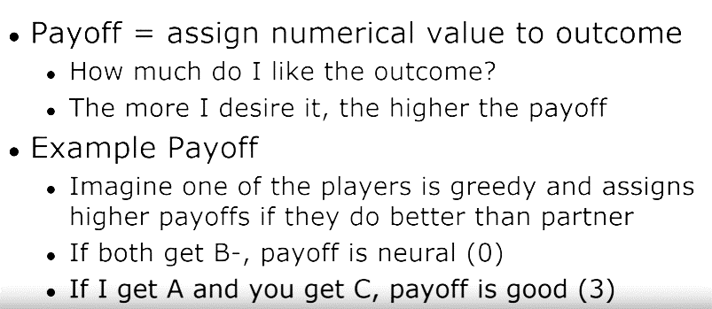
Payoff (Utility) Example

Slide 20
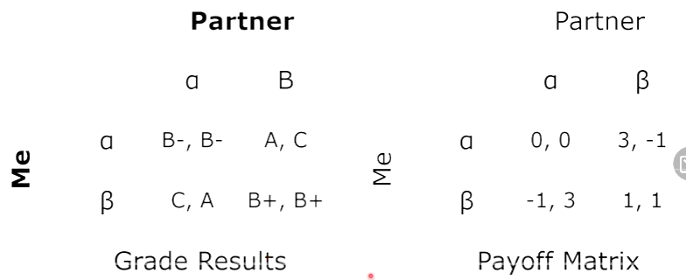
Grades Game Payoffs

Slide 21
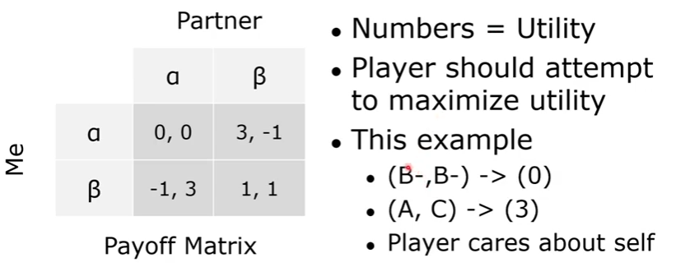
Grades Game Payoffs

Slide 22
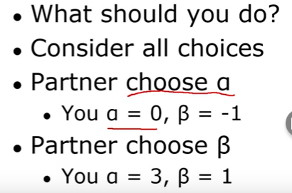
Grades Game Payoffs
What is the best choice?

Slide 23
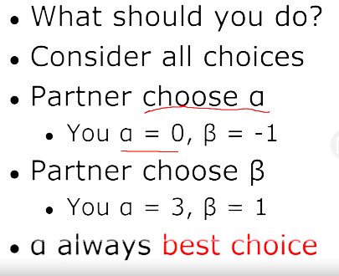
Grades Game Payoffs

Slide 24
Zero-Sum Game
The games most commonly studied within AI (such as chess, tic-tac-toe and Go) are what game theorists call deterministic, two-player, turn-taking, perfect information, zero-sum games.
“Perfect information” is a synonym for “fully observable,”1 and “zero-sum” means that what is good for one player is just as bad for the other: there is no “win-win” outcome.
For games we often use the term move as a synonym for “action” and position as a synonym for “state.”

Slide 25
Zero-Sum Game
Two players MAX and MIN.
MAX moves first, and then the players take turns moving until the game is over. At the end of the game, points are awarded to the winning player and penalties are given to the loser.
One player of the game try to maximize one single value, while other player tries to minimize it.
Each move by one player in the game is called as ply.

Slide 26
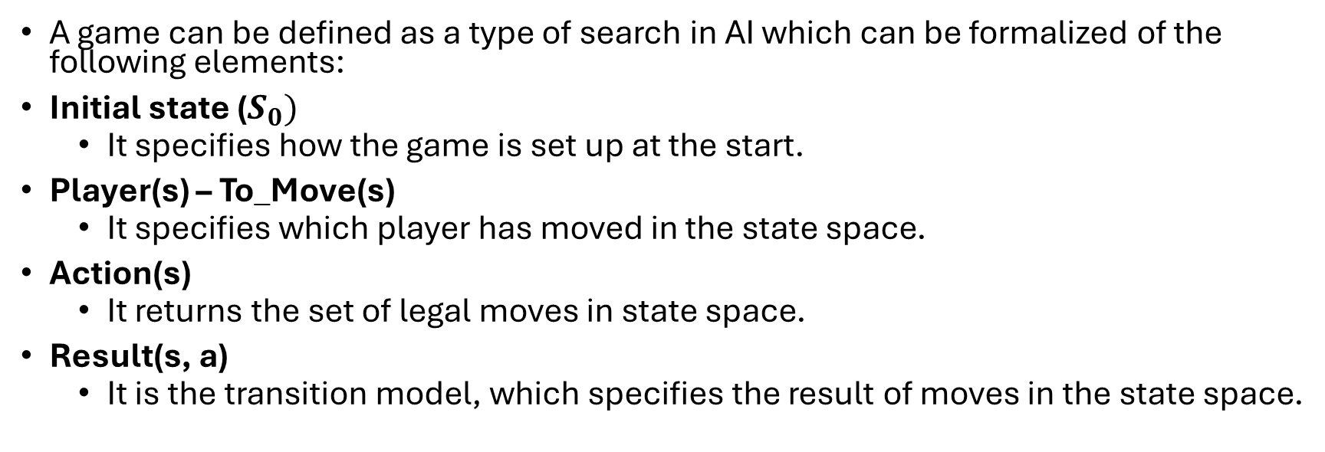
Formalization of the problem
A game can be defined as a type of search in AI which can be formalized of the following elements:
Initial state ($S_{0})$
It specifies how the game is set up at the start.
Player(s) – To_Move(s)
It specifies which player has moved in the state space.
Action(s)
It returns the set of legal moves in state space.
Result(s, a)
It is the transition model, which specifies the result of moves in the state space.

Slide 27
Contd..
Terminal-Test(s)
The state where the game ends is called terminal states.
Terminal test is true if the game is over, else it is false at any case.
Utility(s, p)
A utility function gives the final numeric value for a game that ends in terminal states s for player p. It is also called payoff function. (Reward after winning the game)
For Chess, the outcomes are a win, loss, or draw and its payoff values are +1, 0, ½. And for tic-tac-toe, utility values are +1, -1, and 0

Slide 28
Game tree
The initial state, Actions functions and Result function define game tree for a game.
A game tree is a tree where nodes of the tree are the game states and Edges of the tree are the moves by players.
Also named as search tree and space graph.

Slide 29
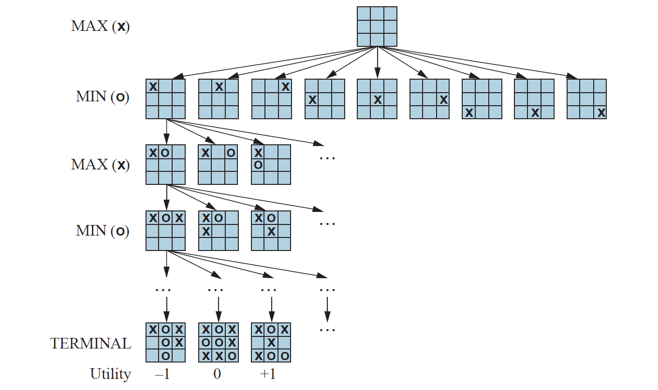
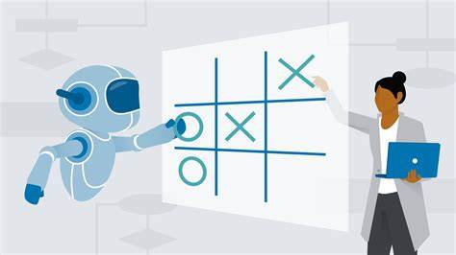
Tic-Tac-Toe game tree
Notes:
For tic-tac-toe the game tree is relatively small—fewer than 9! = 362, 880 terminal nodes (with only distinct
states). But for chess 36 (branches) there are over 10^4 nodes, so the game tree is best thought of as a theoretical construct that we
cannot realize in the physical world.

Slide 30
Mini-Max Algorithm
A recursive or backtracking algorithm
The algorithm proceeds all the way down to the terminal node of the tree, compare the values and backtrack the tree to root node to decide the move.
Performs a depth-first search algorithm for the exploration of the complete game tree.
Best Move strategy used
Both players will adopt best move to not allow the opponent to win
Computes the minimax decision for the current state
Max will try to maximize its utility (Best move)
Min will try to minimize the utility (Worst move)
Notes:
1. Mini-max algorithm is a recursive or backtracking algorithm which is used in decision-making and game theory. It provides an optimal move for the player assuming that opponent is also playing optimally.

Slide 31
Mini-Max Algorithm
Why not BFS? BFS expands the game tree level-by-level and requires storing all nodes at each level, causing massive memory usage.
Minimax needs to evaluate terminal states first, and recursion with backtracking is only possible using DFS. DFS goes directly to leaves, computes utility values, and returns them upward, which is exactly how minimax works.
BFS does not allow efficient backtracking, does not reach terminal nodes early, and is not compatible with the recursive nature of minimax.

Slide 32
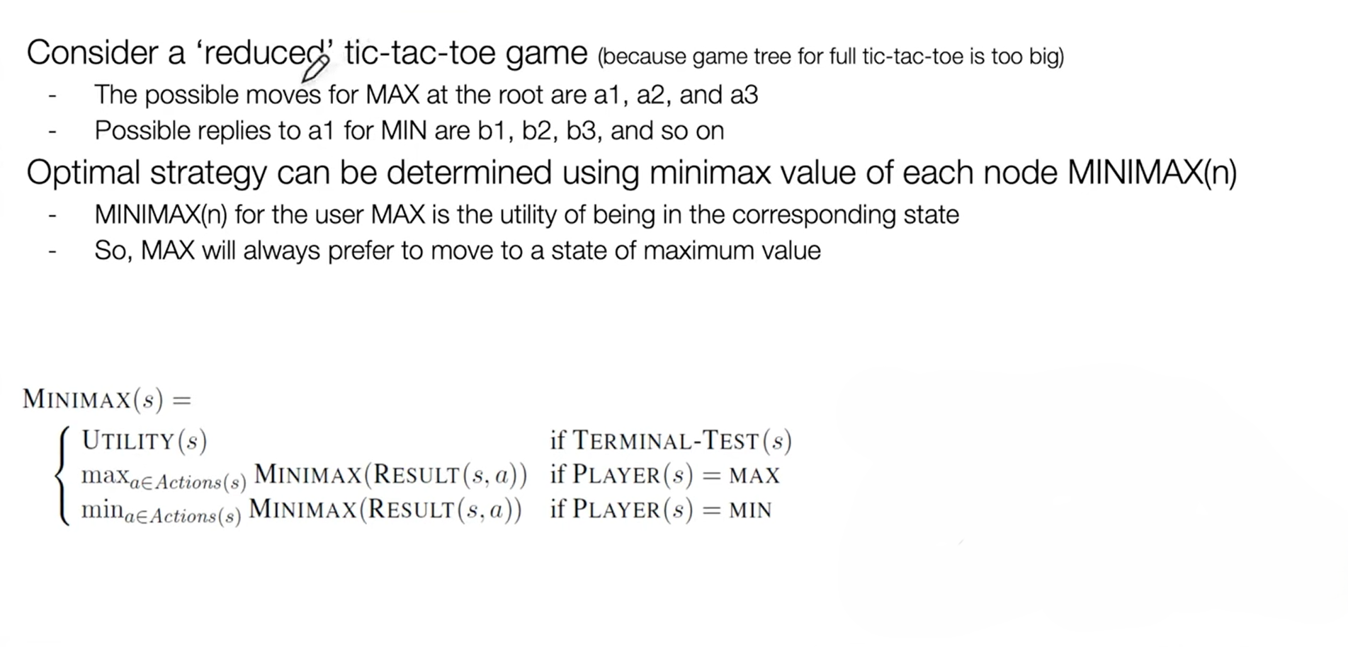
MINMAX Value

Slide 33
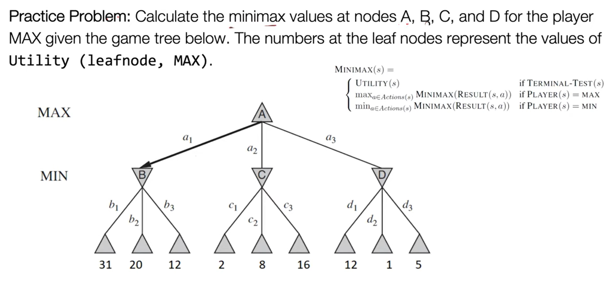

Slide 34
Task
A
B
C
D
E
F
G
H
I
J
K
L
M
N
O
-1
8
-3
-1
2
1
-3
4
Notes:
A->C->F->L with utility of 2

Slide 35

Performance Measurement
Complete ?
YES, It will definitely find a solution (if exist), in the finite search tree.
Optimal ?
YES, if both opponents are playing optimally
Time ?
The worst case time complexity is O(b^{d}). Simply O(n)
Space ?
The worst case space complexity is O(b^{d}).

Slide 36
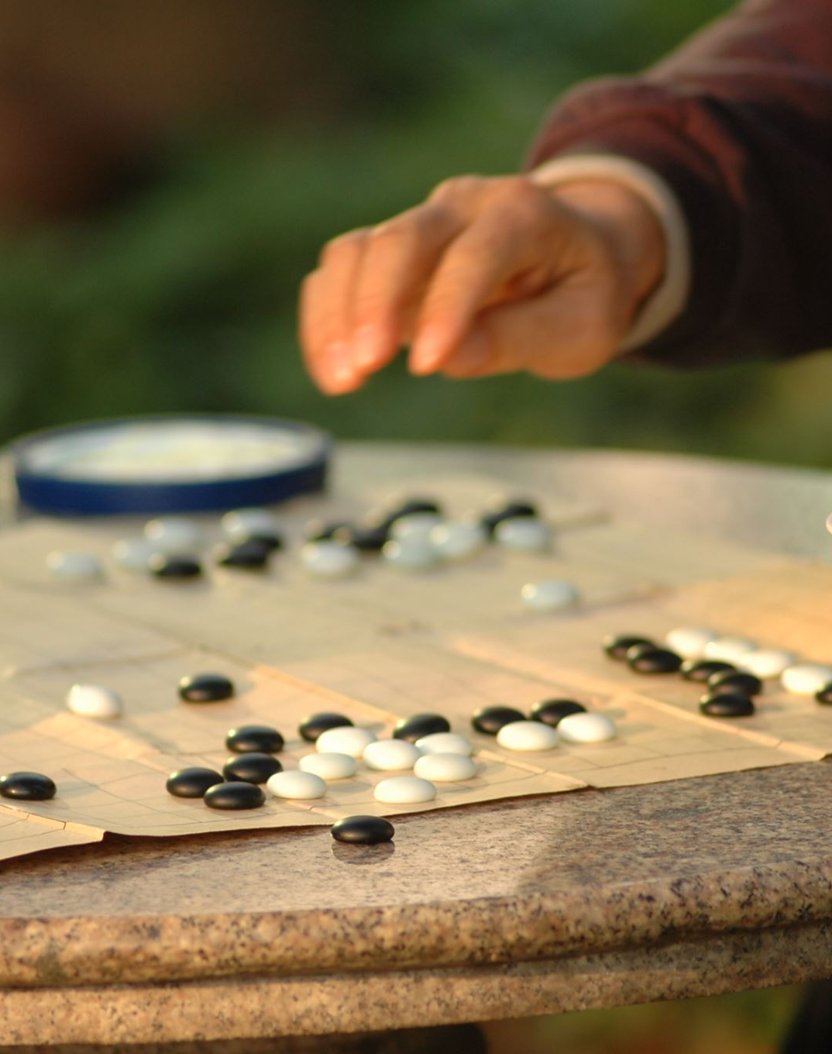
Limitation of the minimax Algorithm
The main drawback of the minimax algorithm is that it gets really slow for complex games such as Chess, go, etc.
This type of games has a huge branching factor, and the player has lots of choices to decide
Traversing becomes complex
Solution
alpha-beta pruning to reduce the tree and increase efficiency
Notes:
For chess, on average 35 choices are possible at a single time. Means 35 branches ,
And on average depth for a single player is 50, then for two players will be 100, so (35)^100
That will make a big game tree and traversing becomes difficult and complex.
https://www.youtube.com/watch?v=Ntu8nNBL28o&ab_channel=GateSmashers

